Slide 1
Capstone Project-3 (UNSUPERVISED PROJECT)
NETFLIX MOVIES AND TV SHOWS CLUSTERING INDIVIDUAL PROJECT Biswajit Gochhayat

Slide 2
CONTENT
INTRO TO UNSUPERVISED ML & NLP
INTODUCTION OF PROJECT
PROBLEM STATEMENT
DATA DESCRIPTION
DATA SUMMARY
DATA PREPARATION
DATA PIPLINE
EXPLORATORY DATA ANALYSIS
TOPIC MODELING
ML MODEL IMPLEMENTATION
CONCLUSION

Slide 3
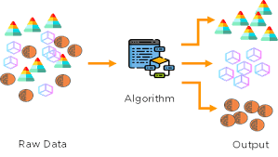

INTRODUCTON TO UML & NLP
Unsupervised machine learning
Unsupervised machine learning uses machine learning algorithms to
analyze and cluster unlabeled datasets. These algorithms discover
hidden patterns or data groupings without the need for human intervention.
What is NLP and how does it work?
Natural Language Processing is a subfield of artificial intelligence (AI).
It helps machines process and understands human language so
that they can automatically perform repetitive tasks. Examples include
machine translation, summarization, ticket classification, and spell check.

Slide 4

PROJECT INTRODUCTON
Netflix is a company that manages a large collection of TV shows and movies, streaming it anytime via online. This business is profitable because users make a monthly payment to access the platform. However, customers
Netflix:
can cancel their subscriptions at any time.
Unsupervised Machine Learning (Clustering)
Methodology:
Netflix Movies and TV Shows
7787 rows and 12 columns
Data from last decade
Database:

Slide 5


PROBLEM STATEMENT
This dataset consists of tv shows and movies available on Netflix as of 2019. The dataset is collected from Flexible which is a third-party Netflix search engine.
In 2018, they released an interesting report which shows that the number of TV shows on Netflix has nearly tripled since 2010. The streaming service’s number of movies has decreased by more than 2,000 titles since 2010, while its number of TV shows has nearly tripled. It will be interesting to explore what all other insights can be obtained from the same dataset.
Integrating this dataset with other external datasets such as IMDB ratings, and rotten tomatoes can also provide many interesting findings.
IN THIS PROJECT REQUIRED TO DO:
EDA
Understanding what type of content is available in different countries
Is Netflix increasingly focused on TV rather than movies in recent years?
Clustering similar content by matching text-based features

Slide 6
DATA DESCRIPTION
The data was collected from Flixable which is third party Netflix search engine. The dataset consists of movies and TV shows data till 2019. The dataset has 7787 rows of data.
The dataset consists of eleven textual columns and one numeric
column.
Attribute Information :
show_id : Unique ID for every Movie / Tv Show
type : Identiﬁer - A Movie or TV Show
title : Title of the Movie / Tv Show
director : Director of the Movie
cast : Actors involved in the movie / show
country : Country where the movie / show was produced
date_added : Date it was added on Netﬂix
release_year : Actual Release year of the movie / show
rating : TV Rating of the movie / show
duration : Total Duration - in minutes or number of seasons
listed_in : Genre
description: The Summary description

Slide 7
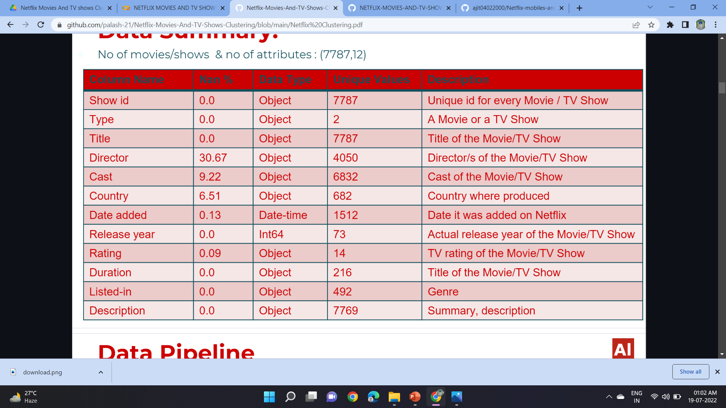
DATA SUMMARY:
NO OF Movies/Shows & No of Attributes(7787,12)

Slide 8
DATA PIPELINE:
DATA CLEANING:
MISSING VALUES: Diractor,Cast,Country,Data Added,Rating.
EDA:Some exploratory data analysis(EDA),Country based analysis,Movies vs Tv Shows analysis for recent years.IMDB dataset is also used to get interesting insights.
Text processing:Removing stop-words ,punctuations,stemming,extracting important word from description feature & using TF-IDF vectorizer.Using PCA to reduce dimension.
Number of cluster:Selecting optimal number of clusters.Techniques used Elbow method,Silhouette analysis,Dendogram.
Clustering: K-means clustering
Evaluation: Checking if the clusters make sense and summary

Slide 9
NULL VALUE:
Null Value Treatment:
● Director feature have more than 30.68% of null values. Filling null values by mode of Diractor.
● Country feature has 6.51% of null values. Filling null values by mode of feature.
● Cast feature have 9.22% of null values. Filling null values by mode of that.
● Rating feature have 0.09% of null values. Filling null values by mode of feature.
● Date_added feature have 0.13% of null values. Dropping rows corresponding to null values.

Slide 10
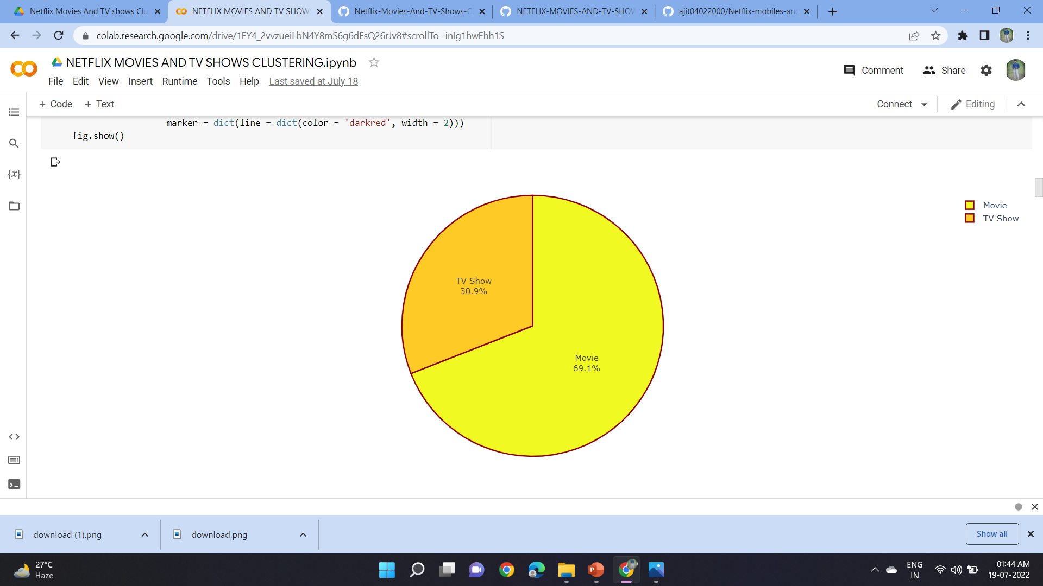
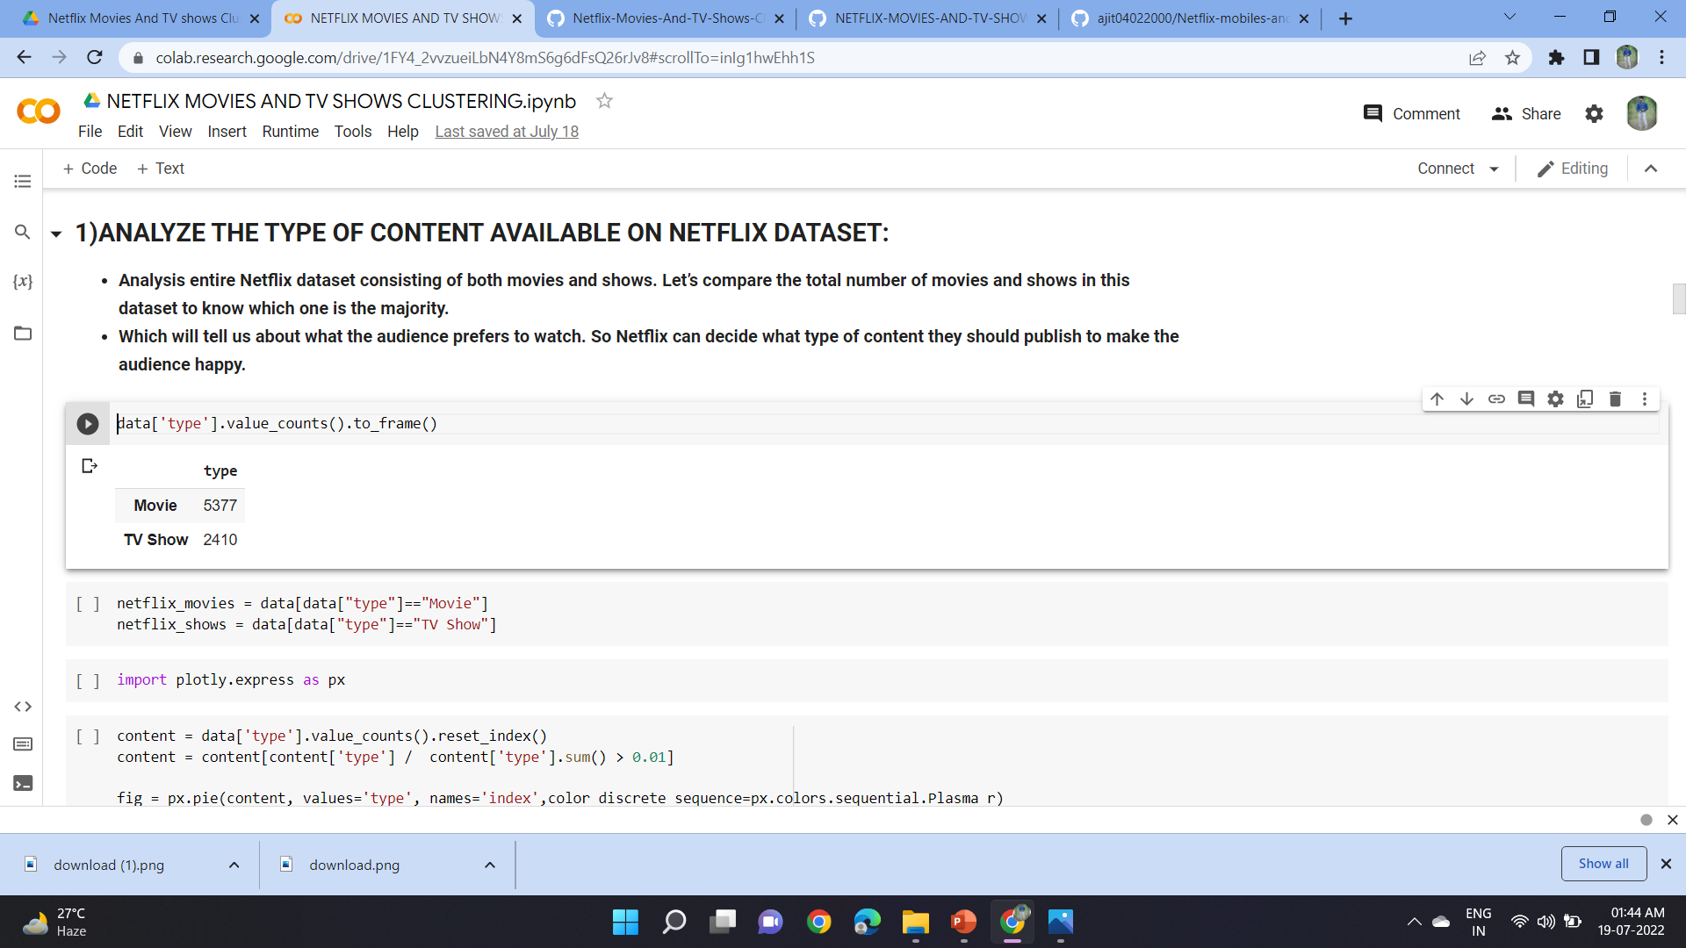
EDA(Exploratory Data Analysis) :
1) ANALYZE THE TYPE OF CONTENT AVAILABLE ON NETFLIX DATASET
It is evident that there are more movies on Netflix than TV shows.
Netflix has 5377 movies, which is more than double the quantity of TV shows.
There are about 70% movies and 30% TV shows on Netflix.
Because the quantity of movies outnumbers the number of TV series. It appears that movies are most widely available in various countries.

Slide 11
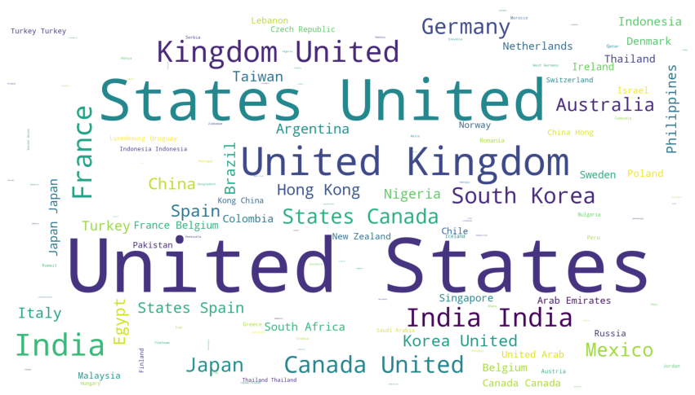
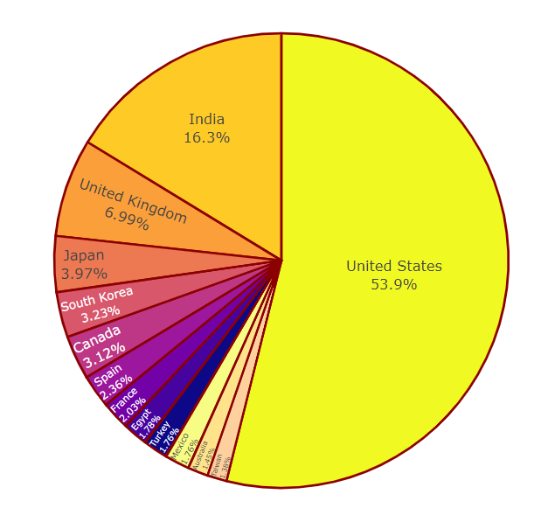
2.Top countries with highest content production
United States has the most number of content on Netflix
India has second highest content on Netflix
Australia and Taiwan has least number of content on Netflix

Slide 12
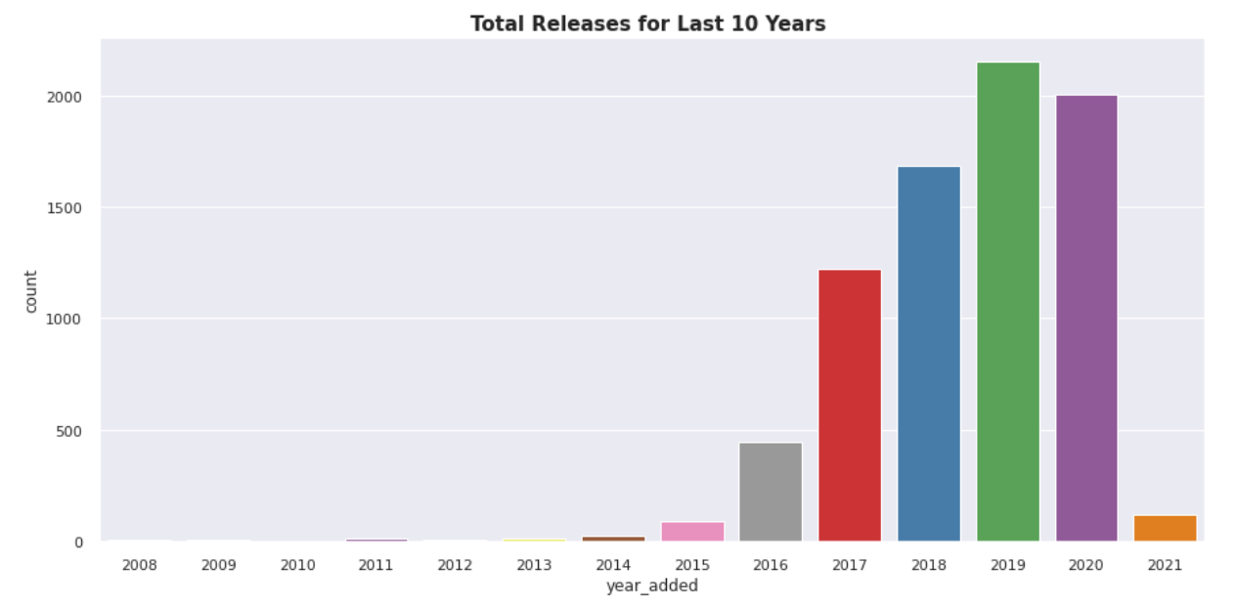
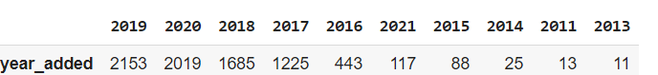
3.Netflix shows Releases over the last 10 years
The number of release have
significantly Increased after
2015 and have dropped in
2021 becase of Covid 19

Slide 13
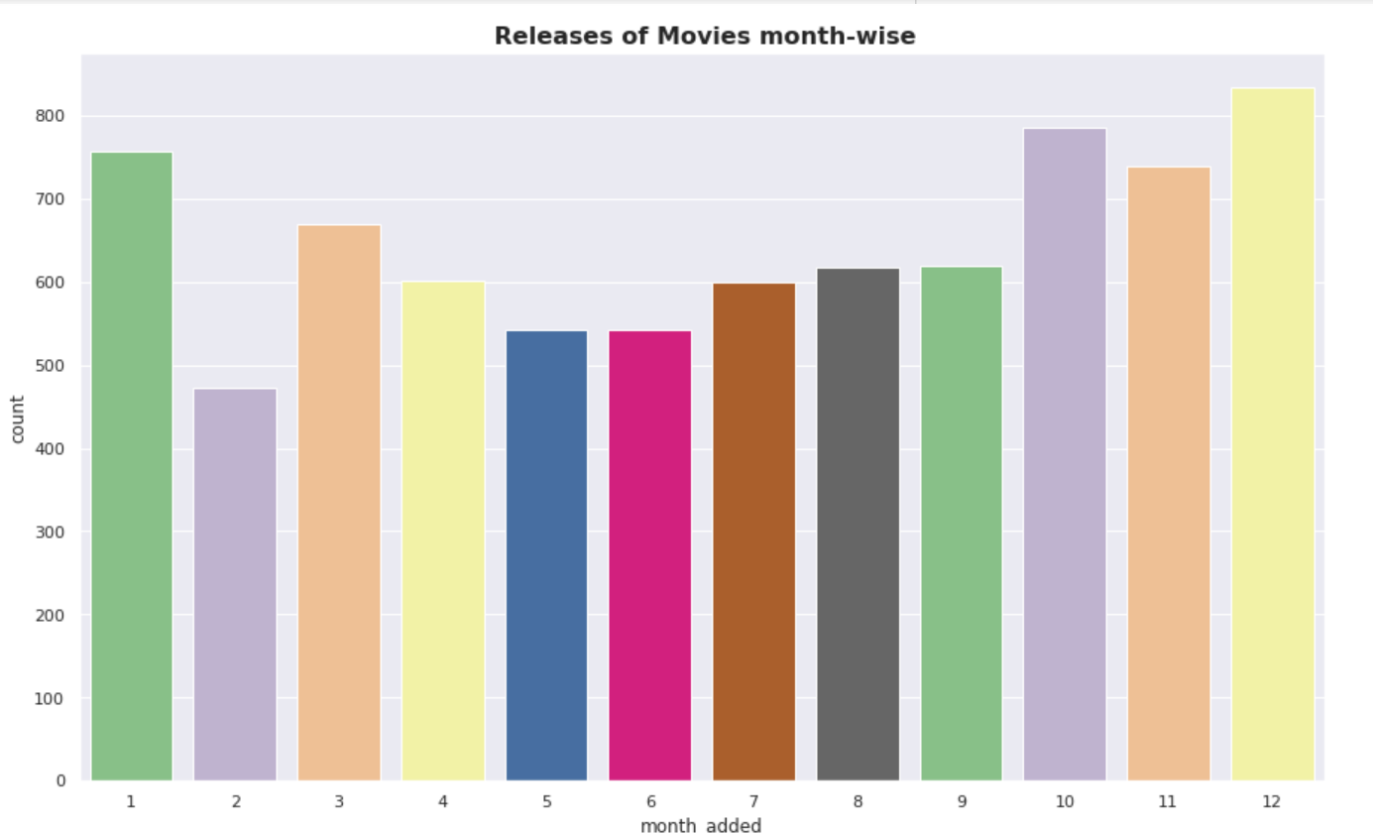
No of movies release monthely wise
More of the content is released in holiday season - October, November, December and January

Slide 14
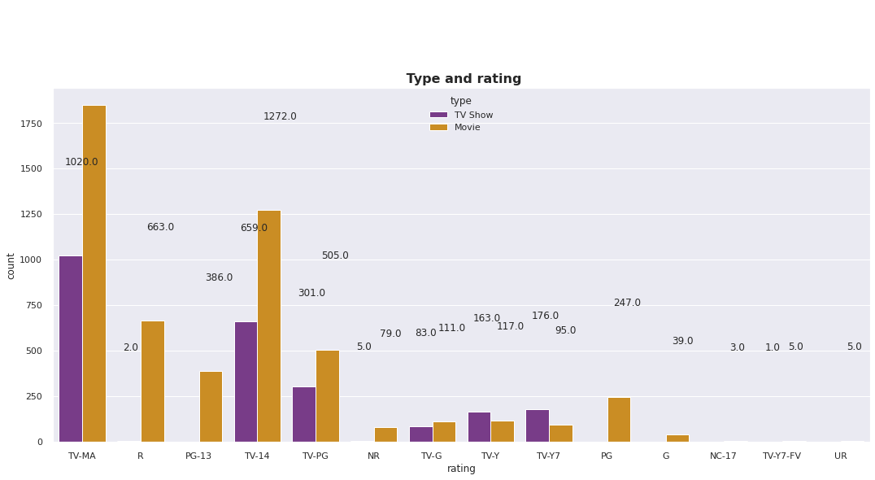
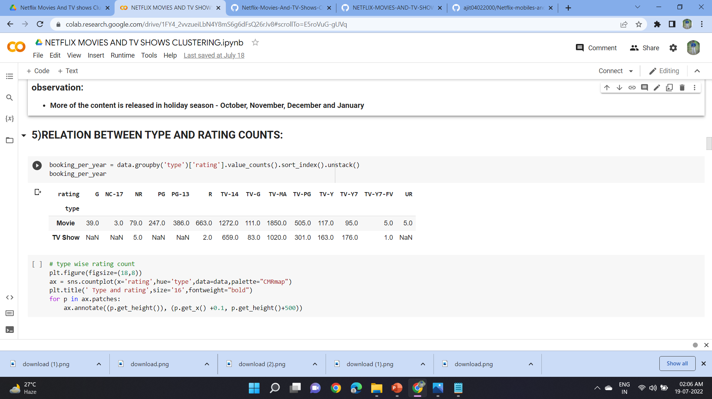
Rating counts Content wise
The largest count of movies are made with the 'TV-MA' rating."TV-MA" is a rating assigned by the TV Parental Guidelines to a television program that was designed for mature audiences only.
* Second largest is the 'TV-14' stands for content that may be inappropriate for children younger than 14 years of age.
* Third largest is the very popular 'R' rating.An R-rated film is a film that has been assessed as having material which may be unsuitable for children under the age of 17 by the Motion Picture Association of America; the MPAA writes "Under 17 requires accompanying parent or adult guardian".

Slide 15
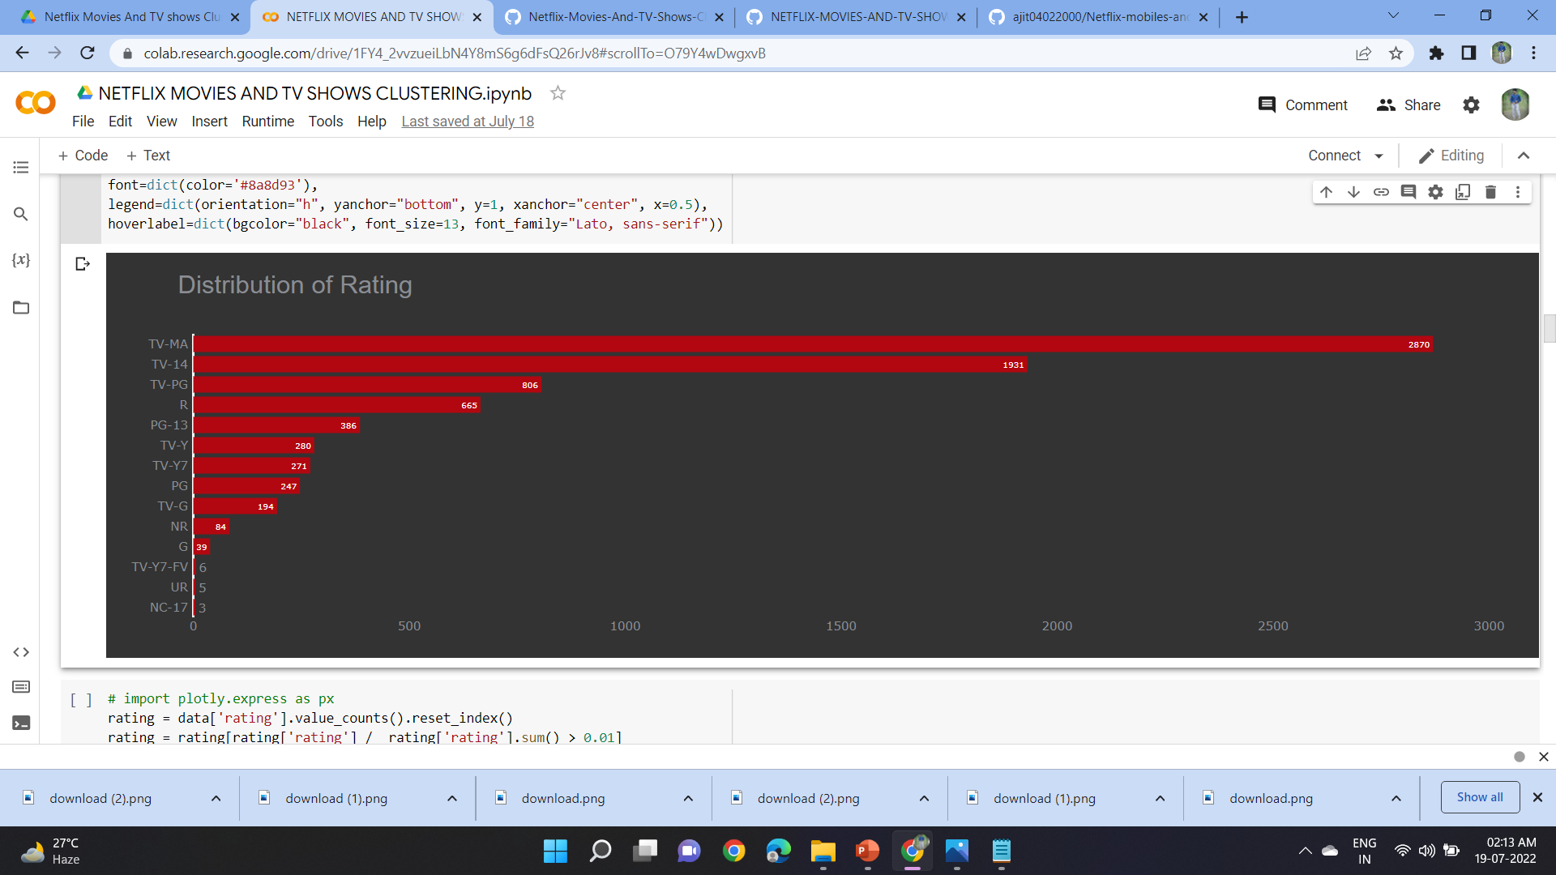
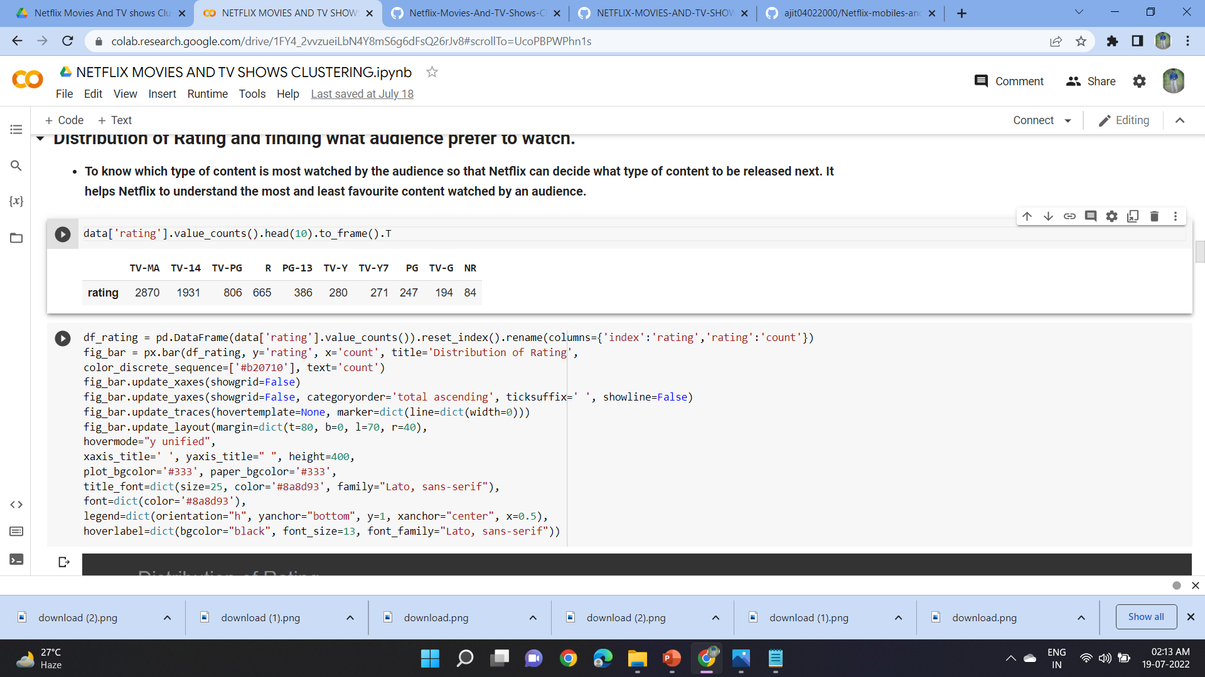
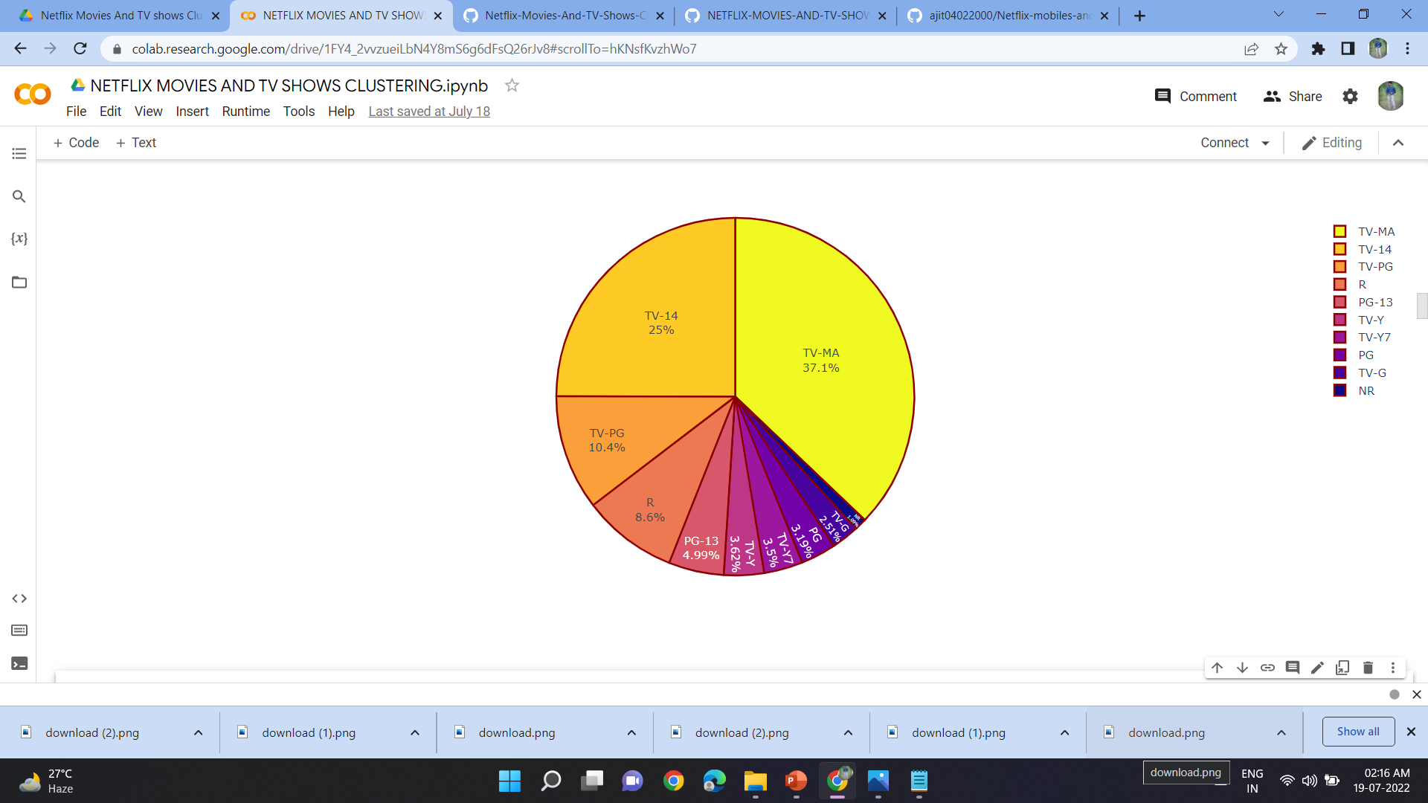
Distribution of Rating and finding what audience prefer to watch.
To know which type of content is most watched by the audience so that Netflix can decide what type of content to be released next. It helps Netflix to understand the most and least favourite content watched by an audience.
* The audience prefers TV-MA and TV-14 shows more and the least preferred rating shows are Nc-17. Most of the content watched by the audience is for a mature audience. The TV-MA rating is a type of rating given by the TV parental guidelines to a television program.
* The second largest type of rating watched by the audience is TV-14 which is inappropriate for children younger than age 14. The conclusion is drawn here is most of the audience is of mature age.

Slide 16
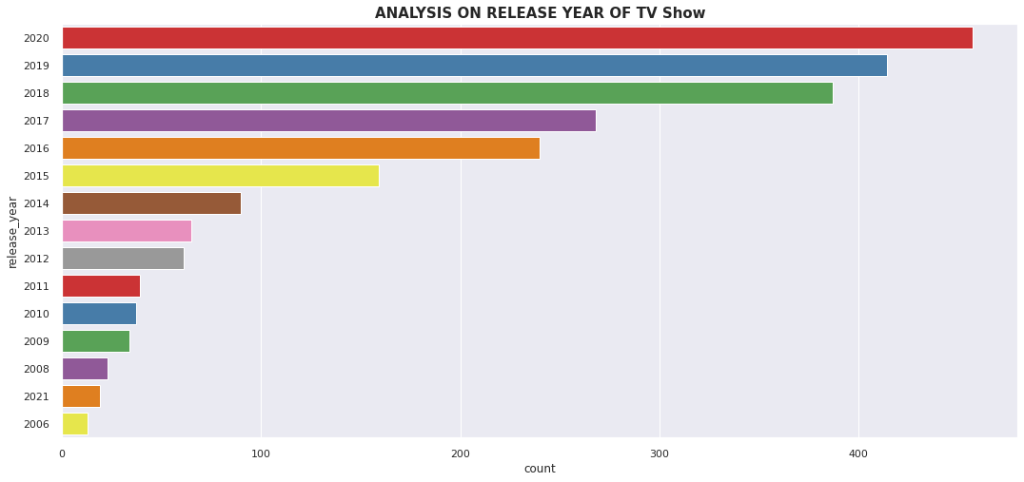
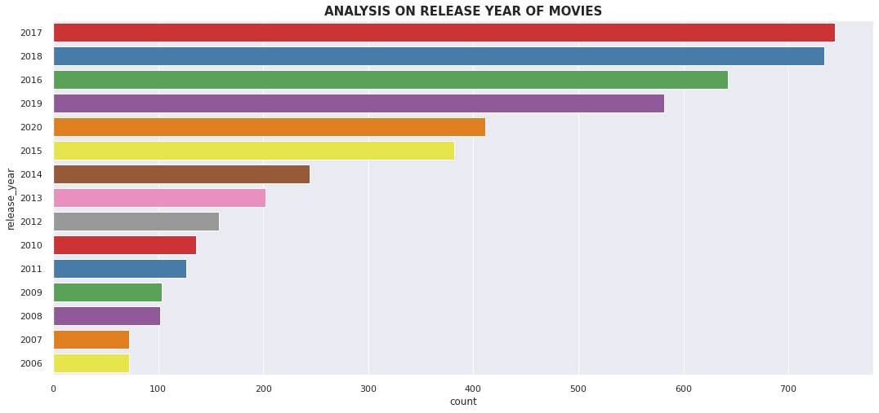
Analysis on release year of months /TV Shows
* 2017 AND 2018 Are the year when most of the fillms are got release.
* The popularity of the movies are getting increased year by year
* 2019 AND 2020 Are the year when most of the Tv shows are got release.
* The popularity of the tv shows are also getting increased year by year

Slide 17
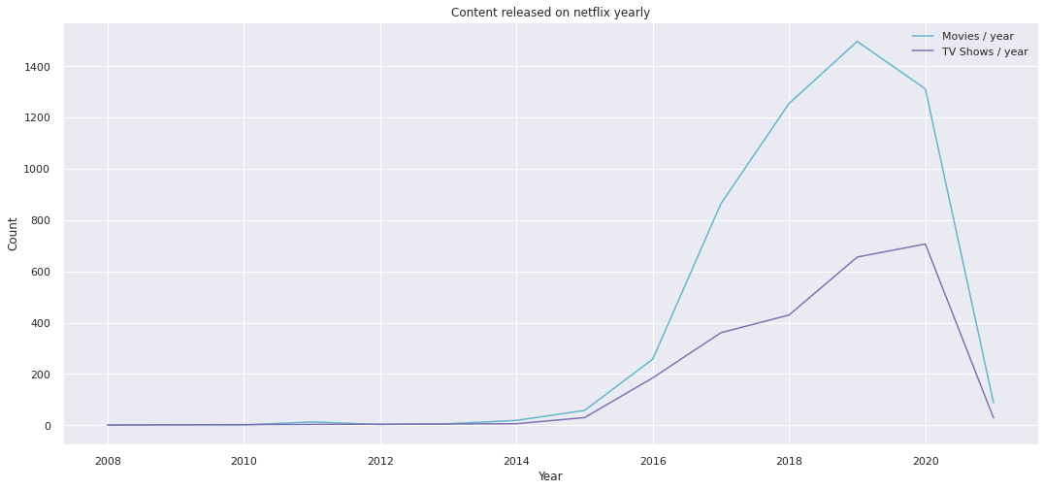
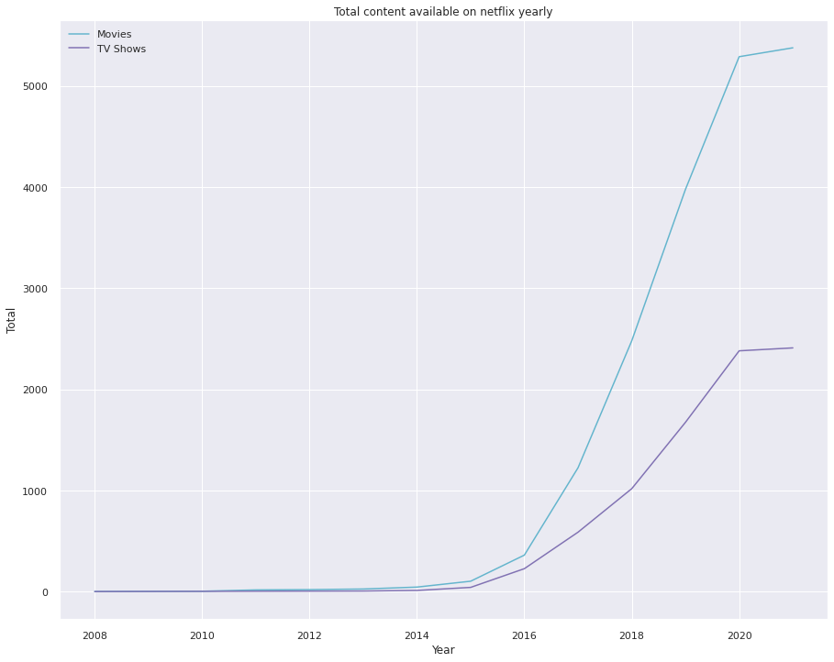
IS NETFLIX HAS INCREASINGLY FOCUSING ON TV RATHER THAN MOVIES IN RECENT YEARS. What is the impact of Netflix TV Shows or Movies over the years by comparing both
* After the year 2019 covid came that badly affects Netflix for producing content. Movies have exponential growth from the start but due to covid, it is going downwards.
* From both these above plots, we can say that Netflix is increasing both TV show & Movies contents.
* Also, they have focused on movies in recent year not the other way round.
We should ignore the year 2021 as we have data for contents added on or before 16/01/21

Slide 18
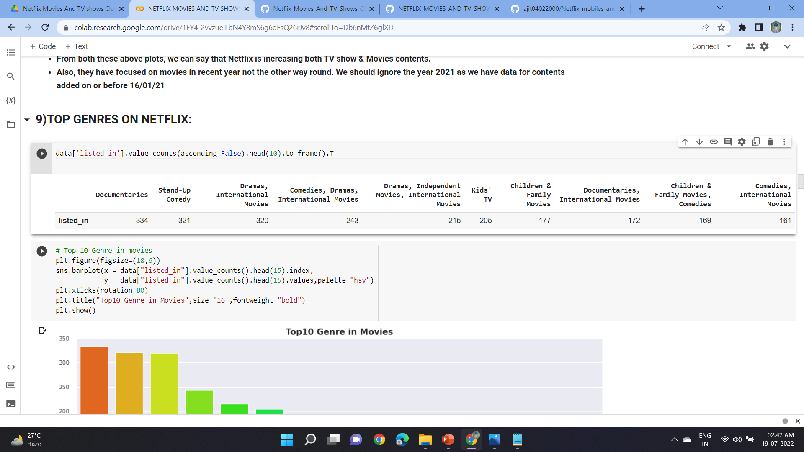
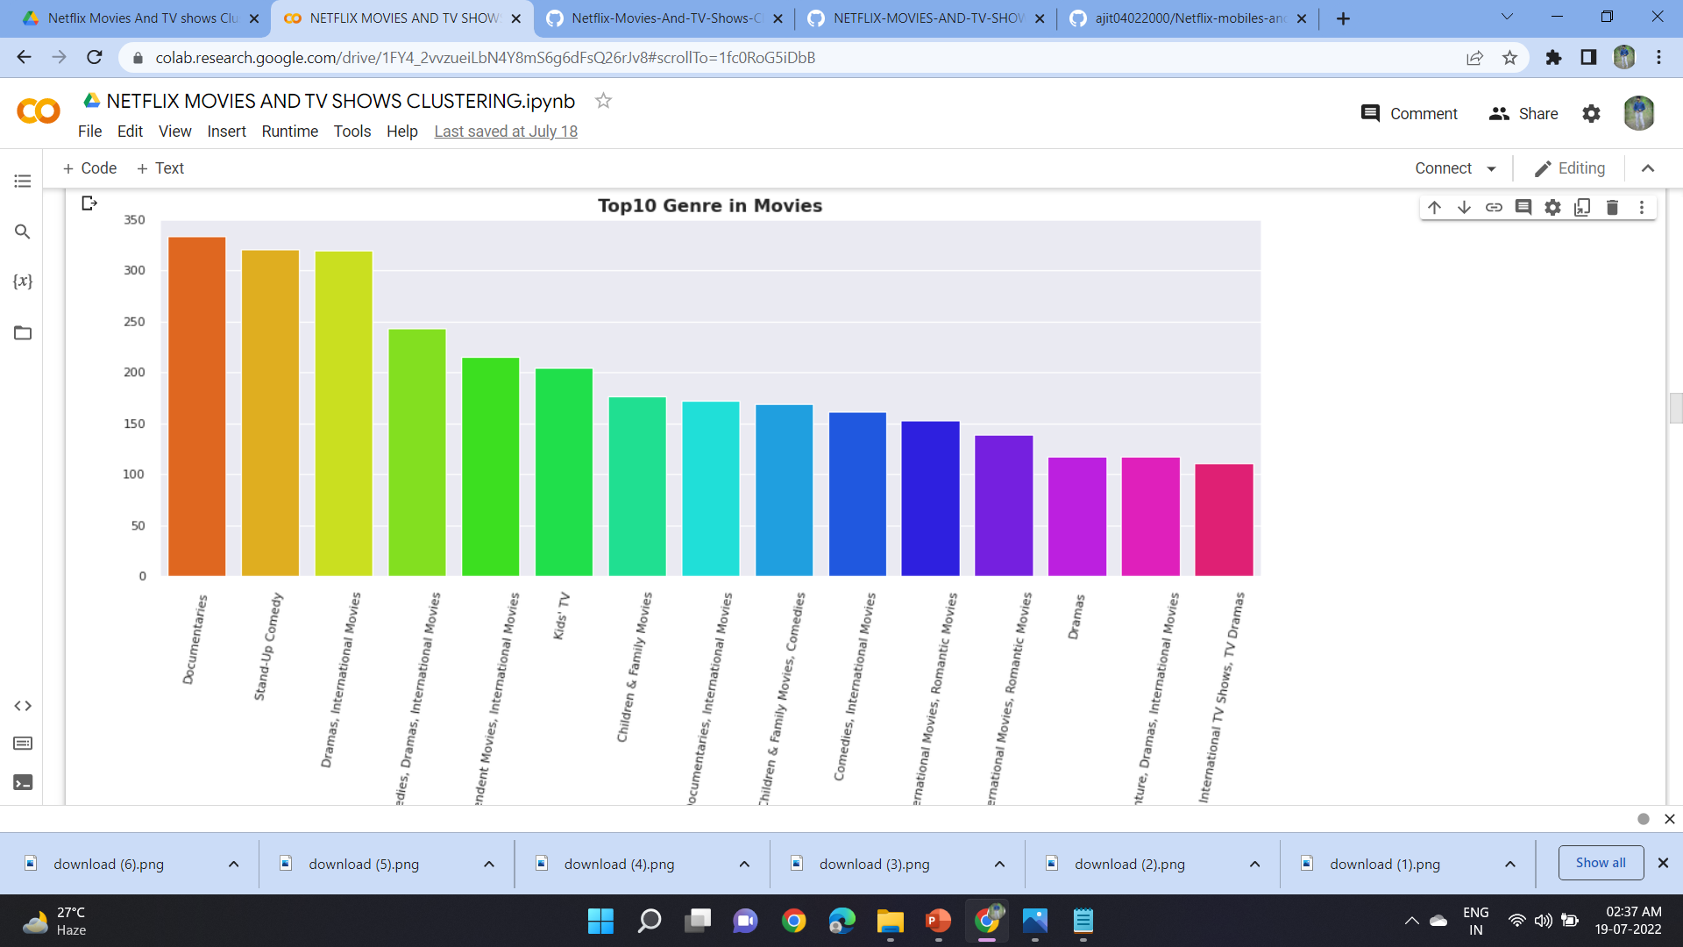
TOP GENRES ON NETFLIX:
* From the graph, we know that Documentaries take the first place, followed by Stand-up Comedy and Dramas,International Movies..

Slide 19
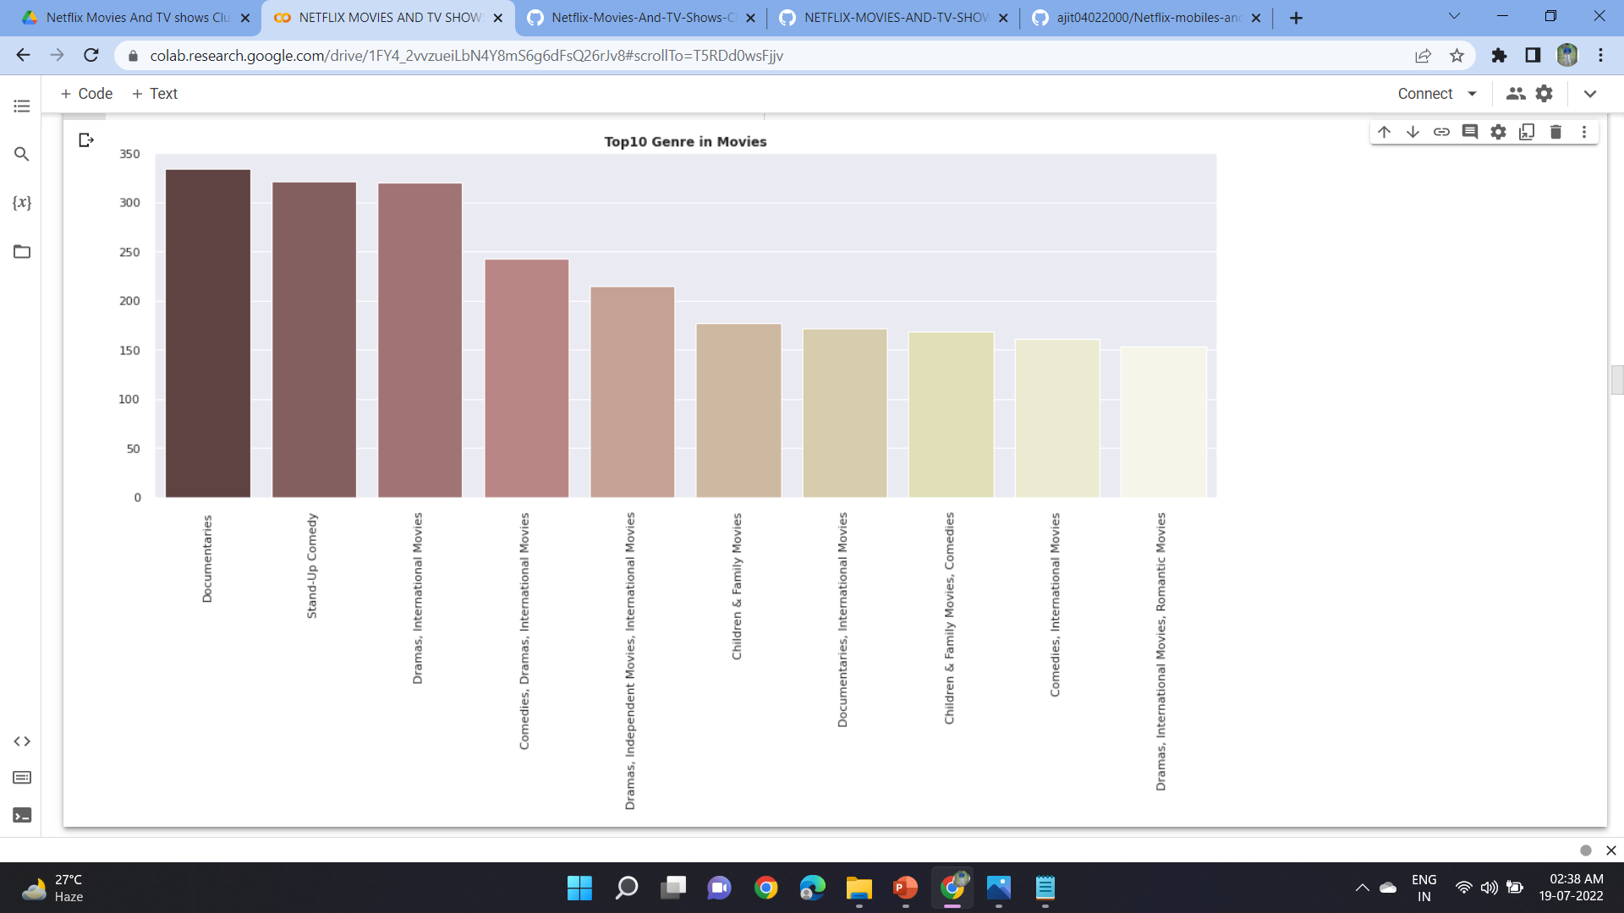
TOP 10 GENRES IN NETFLIX (MOVIES):
Documentries ,Standardup Comedy,Dramas international (Movies)Genere are the most popular netflix_movies.

Slide 20
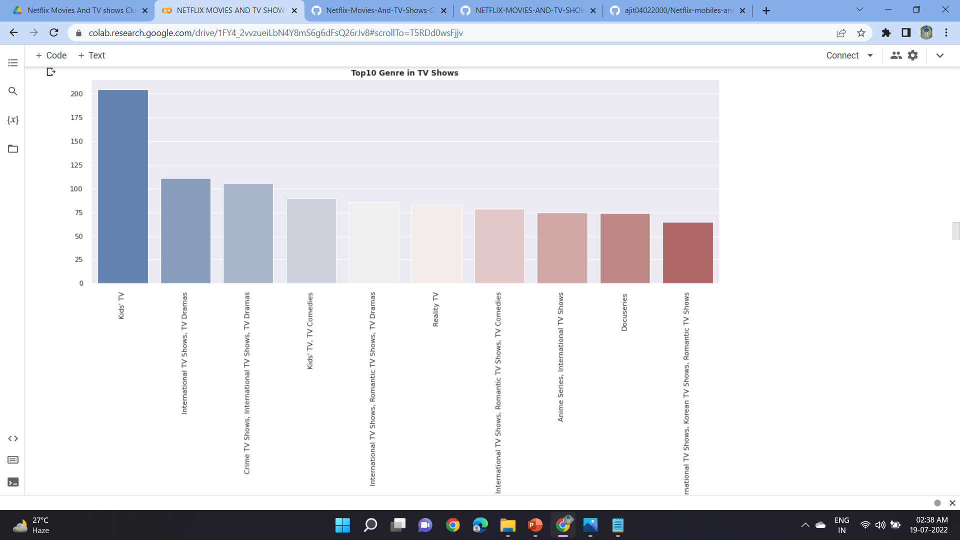
TOP 10 GENERES IN NETFLIX (TVSHOW):
Kids'TV,International Tv shows TV Dramas (tv shows)Genere are the most popular netflix_movies.

Slide 21
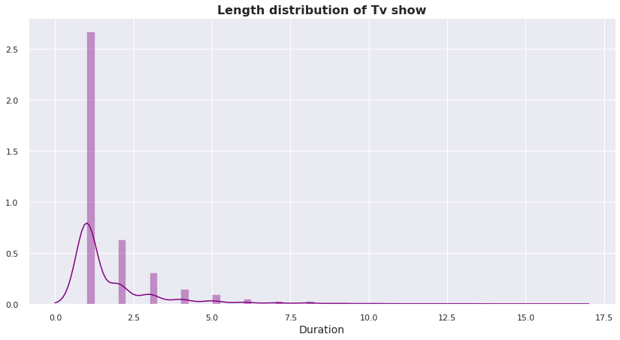
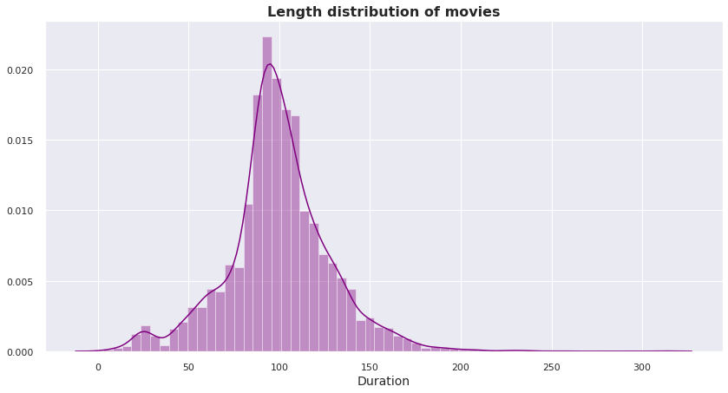
LENGTH DISTRIBUTION OF TV SHOW AND MOVIES
The average time of a movies is 100 to 120 min.

Slide 22
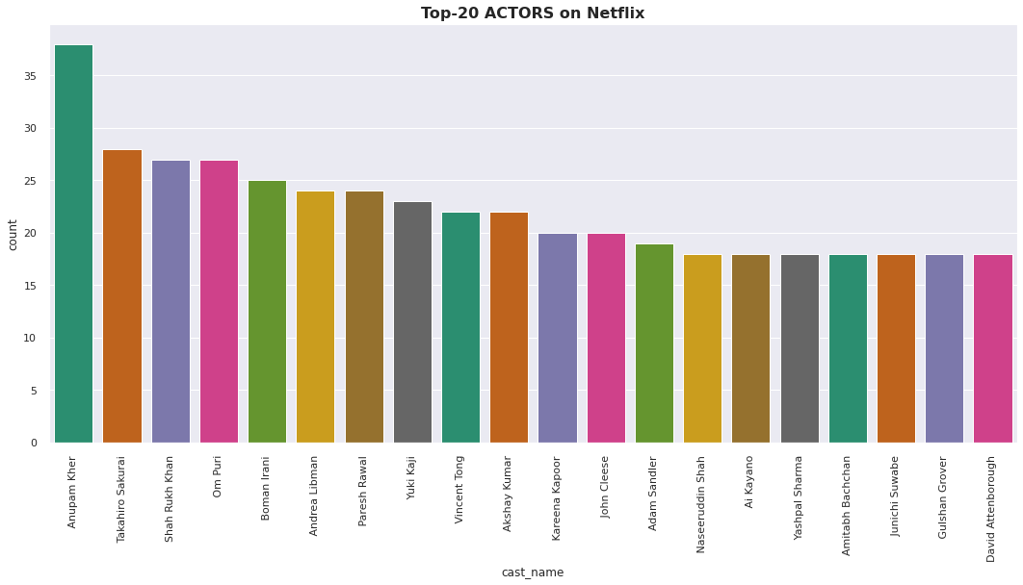
TOP 20 Actors on Netflix:
The top actor on Netflix Movies, based on the number of titles, is Anupam Kheer, and Takahiro Sakurai.

Slide 23
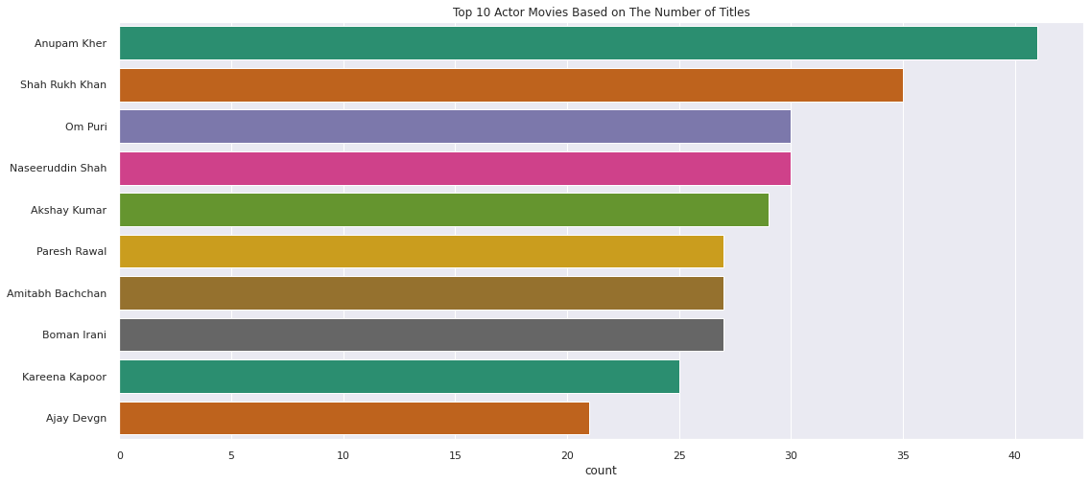
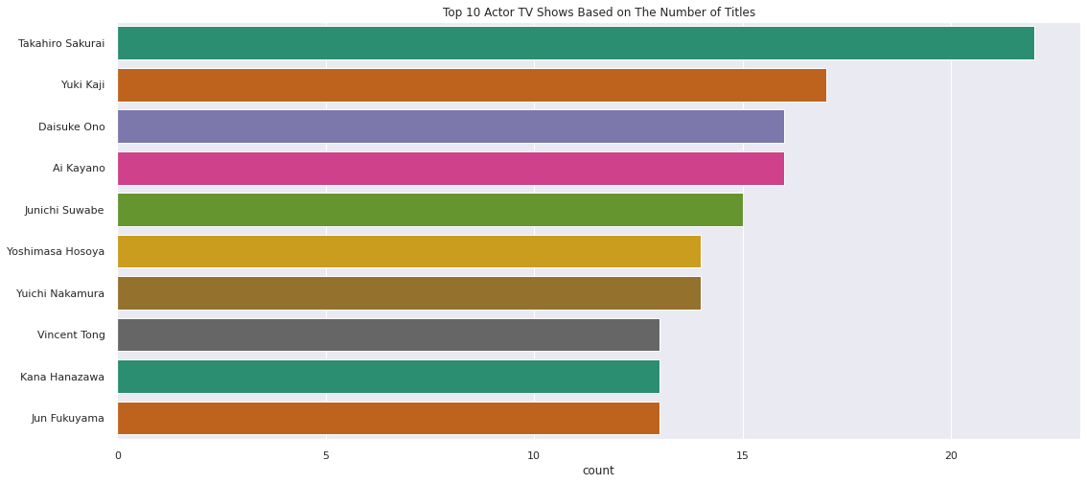
TOP 10 ACTORS IN MOVIES/TV SHOWS
The top actor on Netflix TV_show, based on the number of titles, is Takahiro Sakurai, and t top actor on Netflix Movies, based on the number of titles, is Anupam Kheer and The 2nd top was Shah rukh khan.
Sakurai.

Slide 24
LABLE ENCODING:
Label Encoding
Lemmatisation- Lemmatization, unlike Stemming, reduces the inflected words properly ensuring that the root word belongs to the language. In Lemmatization root word is called Lemma. ... For example, runs, running, ran are all forms of the word run, therefore run is the lemma of all these words.
Removing Stop words - To remove stop words from a sentence, you can divide your text into words and then remove the word if it exits in the list of stop words provided by NLTK.
Tf - idf Vectorization - TF-IDF stands for “Term Frequency — Inverse Document Frequency”.
This is a technique to quantify a word in documents, we generally compute a weight to each word which signifies the importance of the word in the document and corpus. This method is a widely used technique in Information Retrieval and Text Mining.
Min-max Scaling - For each value in a feature, MinMaxScaler subtracts the minimum value in
the feature and then divides by the range. It preserves shape of original distribution.

Slide 25
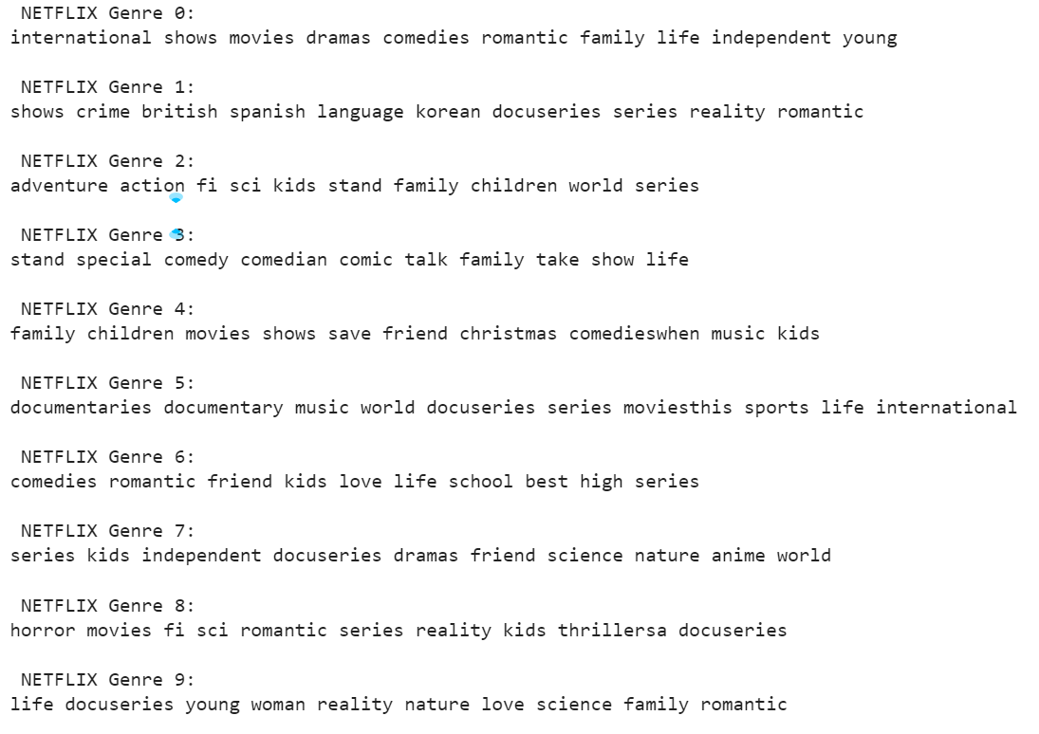
TOPIC MODELLING (LDA & LSA)
Latent semantic analysis (LSA) is a technique in natural language processing, in particular distributional semantics, of analyzing relationships between a set of documents and the terms they contain by producing a set of concepts related to the documents and terms. LSA assumes that words that are close in meaning will occur in similar pieces of text

Slide 26
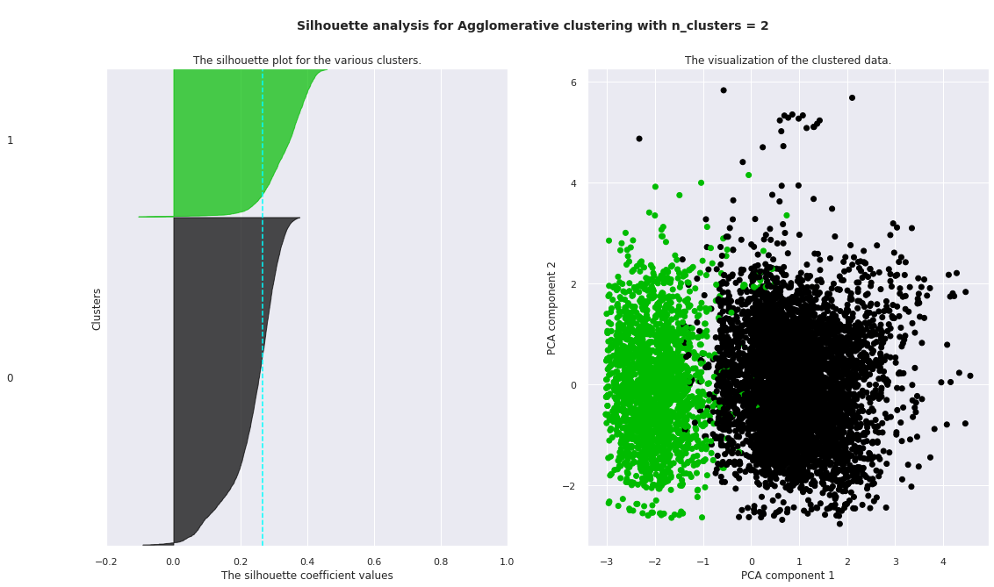
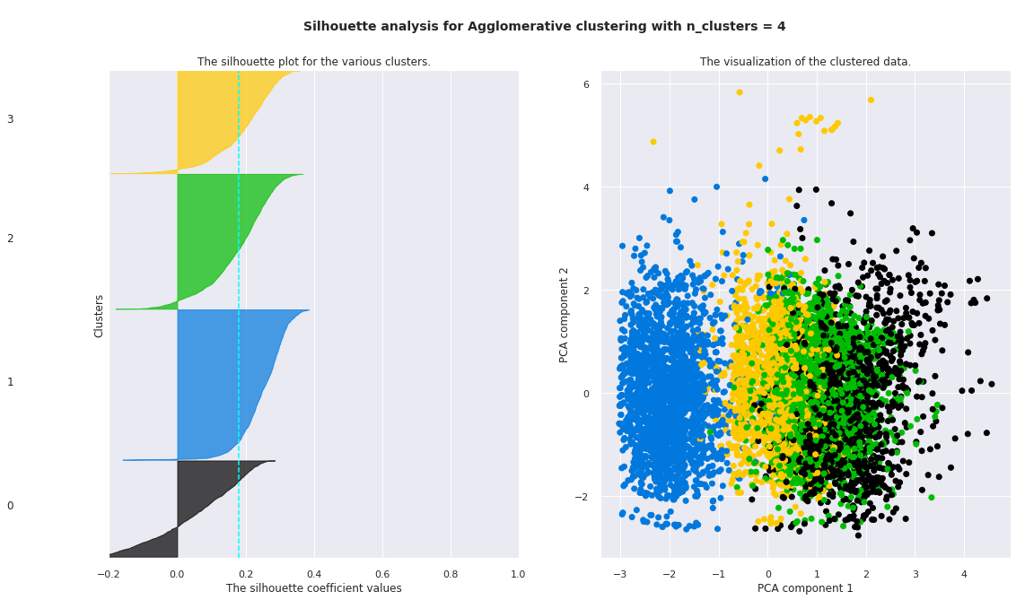
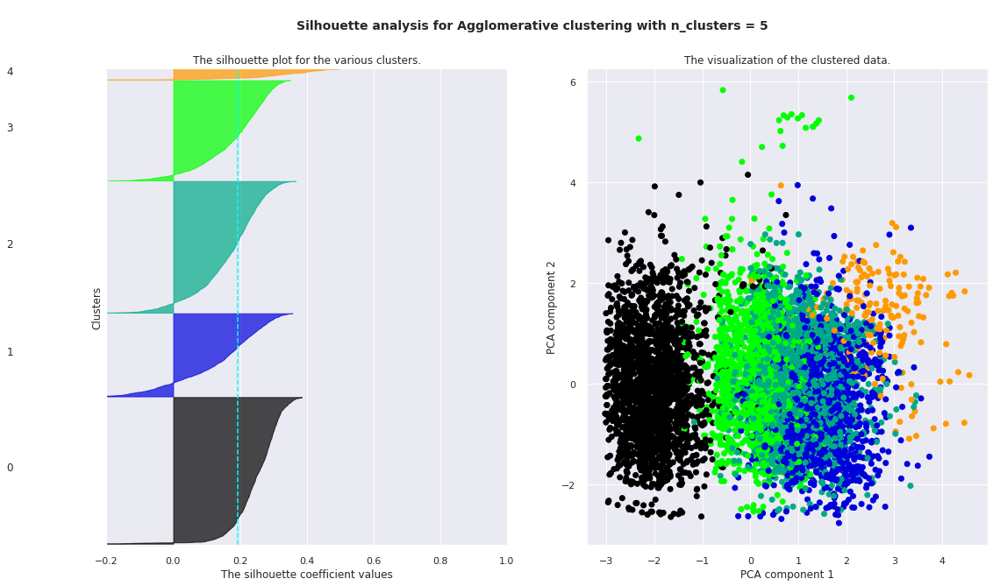
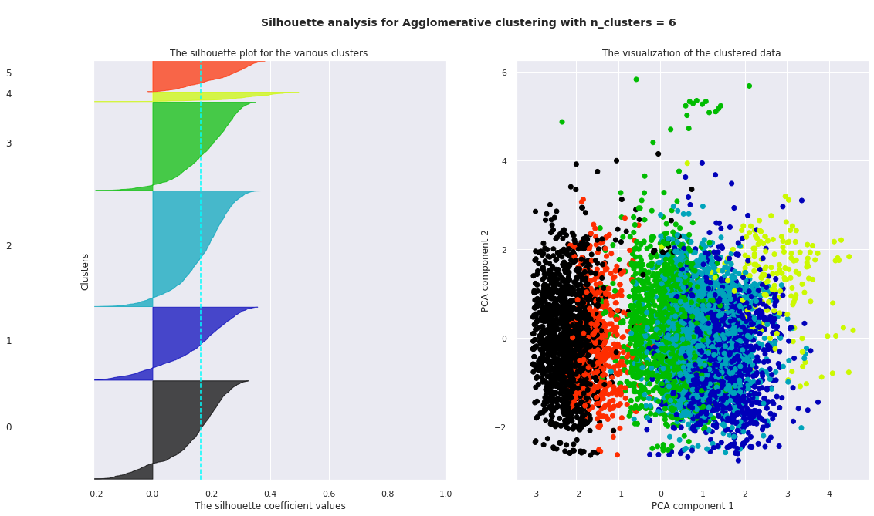

ML MODEL IMPLEMENTATION
1. Agglomerative Propagation
For n_clusters = 2 The average silhouette_score is : 0.2666501490102767
For n_clusters = 4 The average silhouette_score is: 0.1800271513466161
For n_clusters = 5 The average silhouette_score is : 0.19419177406687443
For n_clusters = 6 The average silhouette_score is : 0.16466299191465364

Slide 27
K-MEAN
To process the learning data, the K-means algorithm in data mining starts with a first group of randomly selected centroids, which are used as the beginning points for every cluster, and then performs iterative (repetitive) calculations to optimize the positions of the centroids
It halts creating and optimizing clusters when either:
The centroids have stabilized — there is no change in their values because the clustering has been successful.
The defined number of iterations has been achieved
K- MEAN CLUSTERING
K-means algorithm is an iterative algorithm that tries to partition the dataset into K pre defined distinct non overlapping subgroups where each data point belongs to only one group.
1. Elbow Curve:
● The Elbow Curve is one of the most popular methods to determine this optimal value of k.
● The elbow curve uses the sum of squared distance (SSE)to choose an ideal value of k based on the distance between the data points and their assigned clusters.
2. Silhouette score :
● Silhouette score is used to evaluate the quality of clusters created using clustering algorithms such as K Means in terms of how well samples are clustered with other samples that are similar to each other.

Slide 28
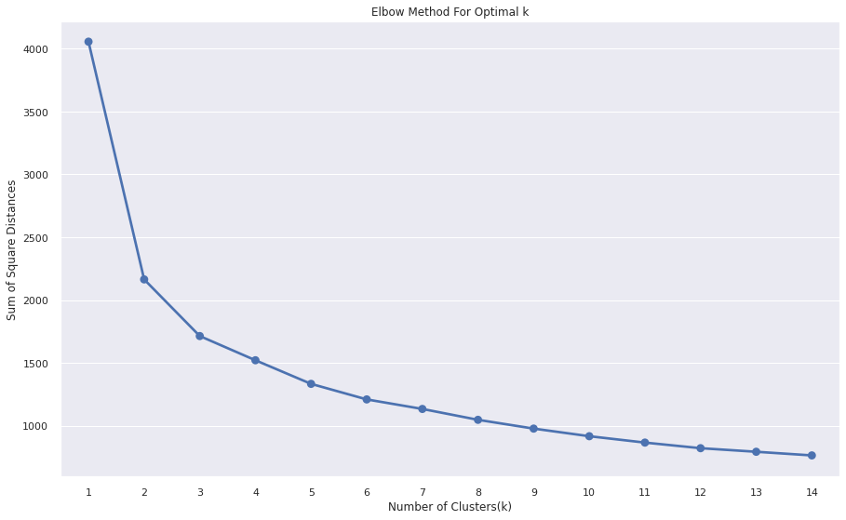
ELBOW CURVE FOR K –MEAN

Slide 29
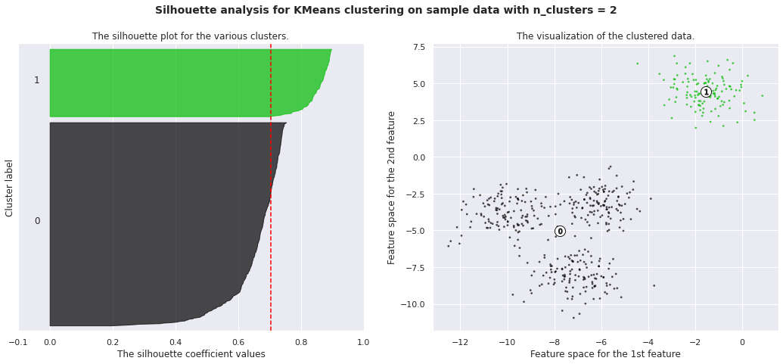
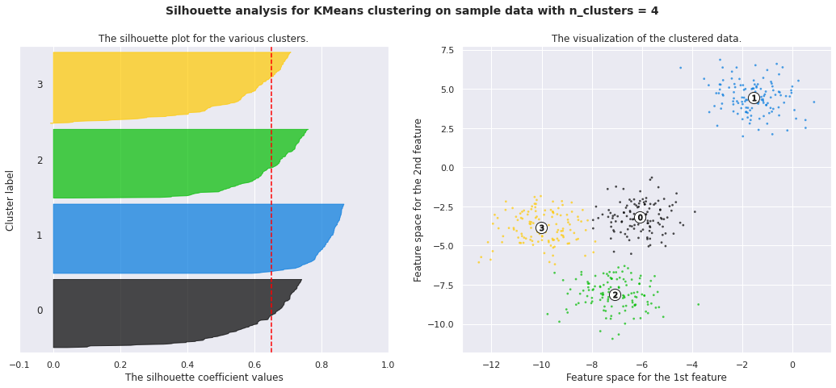
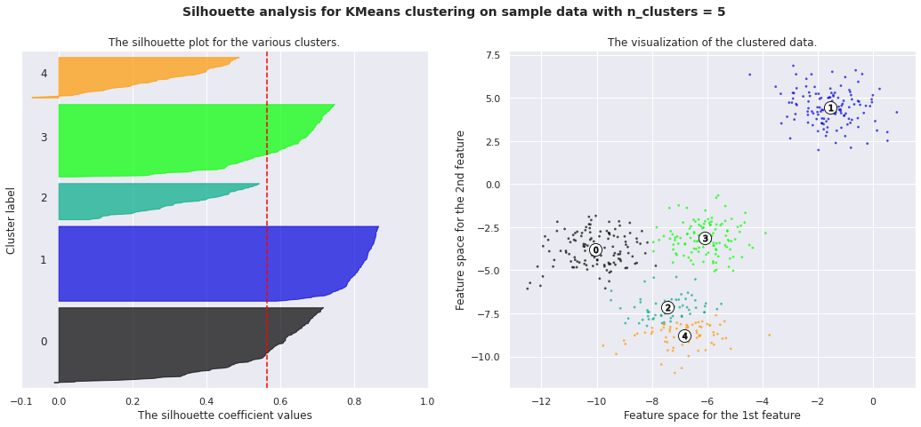
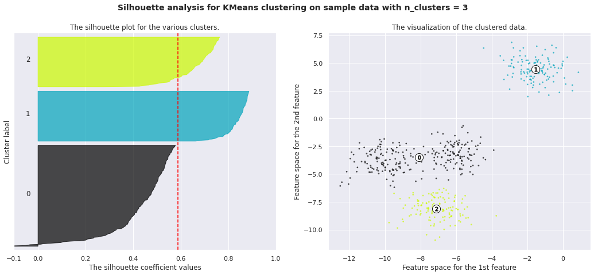
K-MEANS CLUSTERING:

Slide 30
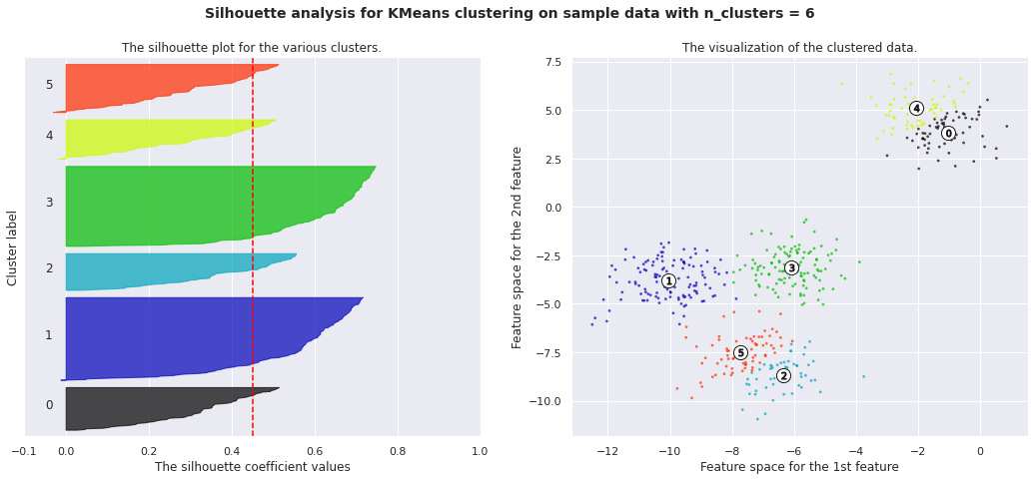
K-MEAN CLUSTERING
Here is the Silhouette analysis done on the above plots to select an optimal value for n_clusters.
The value of 4 and 5 for n_clusters looks to be the optimal one. The silhouette score for each cluster is above average silhouette scores.
For n_clusters = 2 The average silhouette_score is : 0.7049787496083262
For n_clusters = 3 The average silhouette_score is : 0.5882004012129721
For n_clusters = 4 The average silhouette_score is : 0.6505186632729437
For n_clusters = 5 The average silhouette_score is : 0.56376469026194
For n_clusters = 6 The average silhouette_score is : 0.4504666294372765

Slide 31
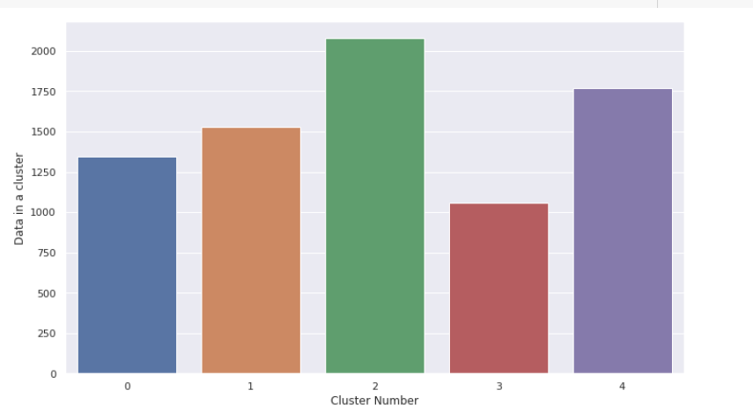
Clusters
We clearly see that one cluster is the largest and one cluster has the fewest number of movies.

Slide 32

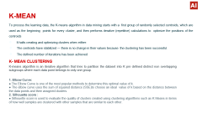
Conclusion
Data set contains 7787 rows and 12 columns in that cast and director features contains large number of missing values so we can drop it.
We have two types of content TV shows and Movies (30.9% contains TV shows and 69.1% contains Movies).
Most films were released in the years 2018, 2019, and 2020 and united states have the maximum content on Netflix.
The months of October, November, December and January had the largest number of films and Tv-shows released.
The USA, India, the United Kingdom, Canada, and Egypt are the top five producer countries.
For the clustering algorithm, we utilized type, director, nation, released year, genre, and year.
LDA and LSA has sorted much more similar titles in a group of genre.
Applied different clustering models Kmeans, hierarchical, Agglomerative clustering on data we got the best cluster arrangements.
In Affinity Propagation, we had 13 clusters and a Silhouette Coefficient score of 0.244.
We cut vertical lines with a horizontal line to obtain the number of clusters in Agglomerative Clustering. There were four clusters, with an average silhouette score of 0.17296314851287742.
The final model we used was k-means clustering, which consisted of 2,3,4,5,6 clusters. 4 numbers of clusters gives us good fitting.
After applying K - means optimal value of number of clusters is 5
Silhouette score for a set of sample data points is used to measure how dense and well-separated the clusters are.
THANK YOU
.

